Slide 1
CFB – CONSUMING Foreign Bodies
Afeez Alli-Balogun

Slide 2
Identidying social issues
Poverty
Homelessness
Health
Affirmative Action

Slide 3
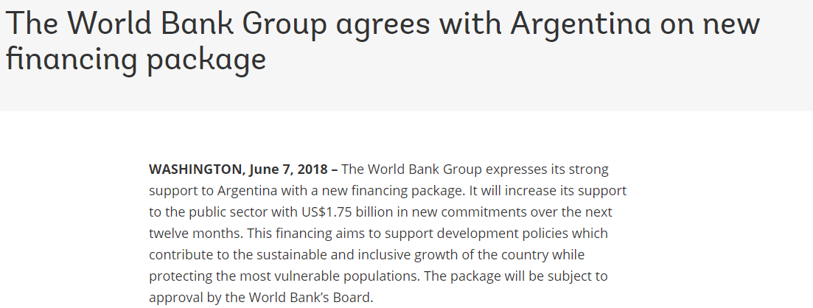
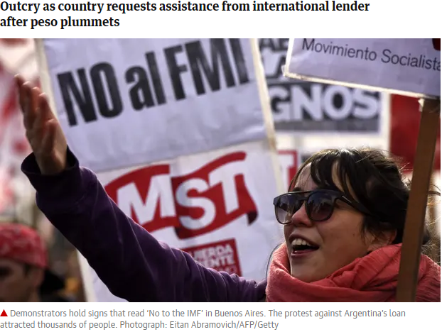
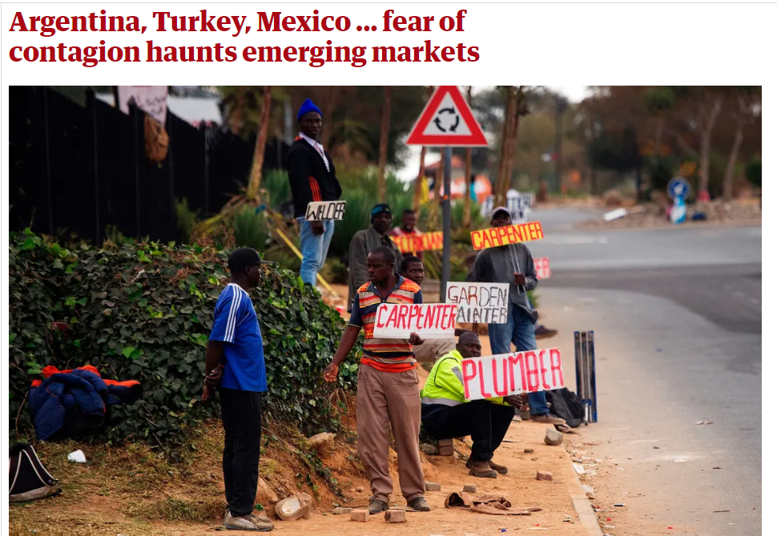
Health awareness and sustainability

Slide 4

Where Do we Start?

Slide 5
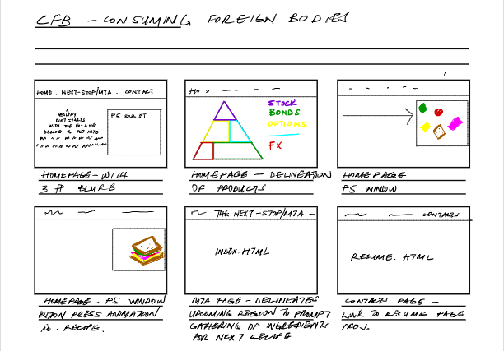
The Process
What inspiration do we all share….
….my initial layout started as such.

Slide 6
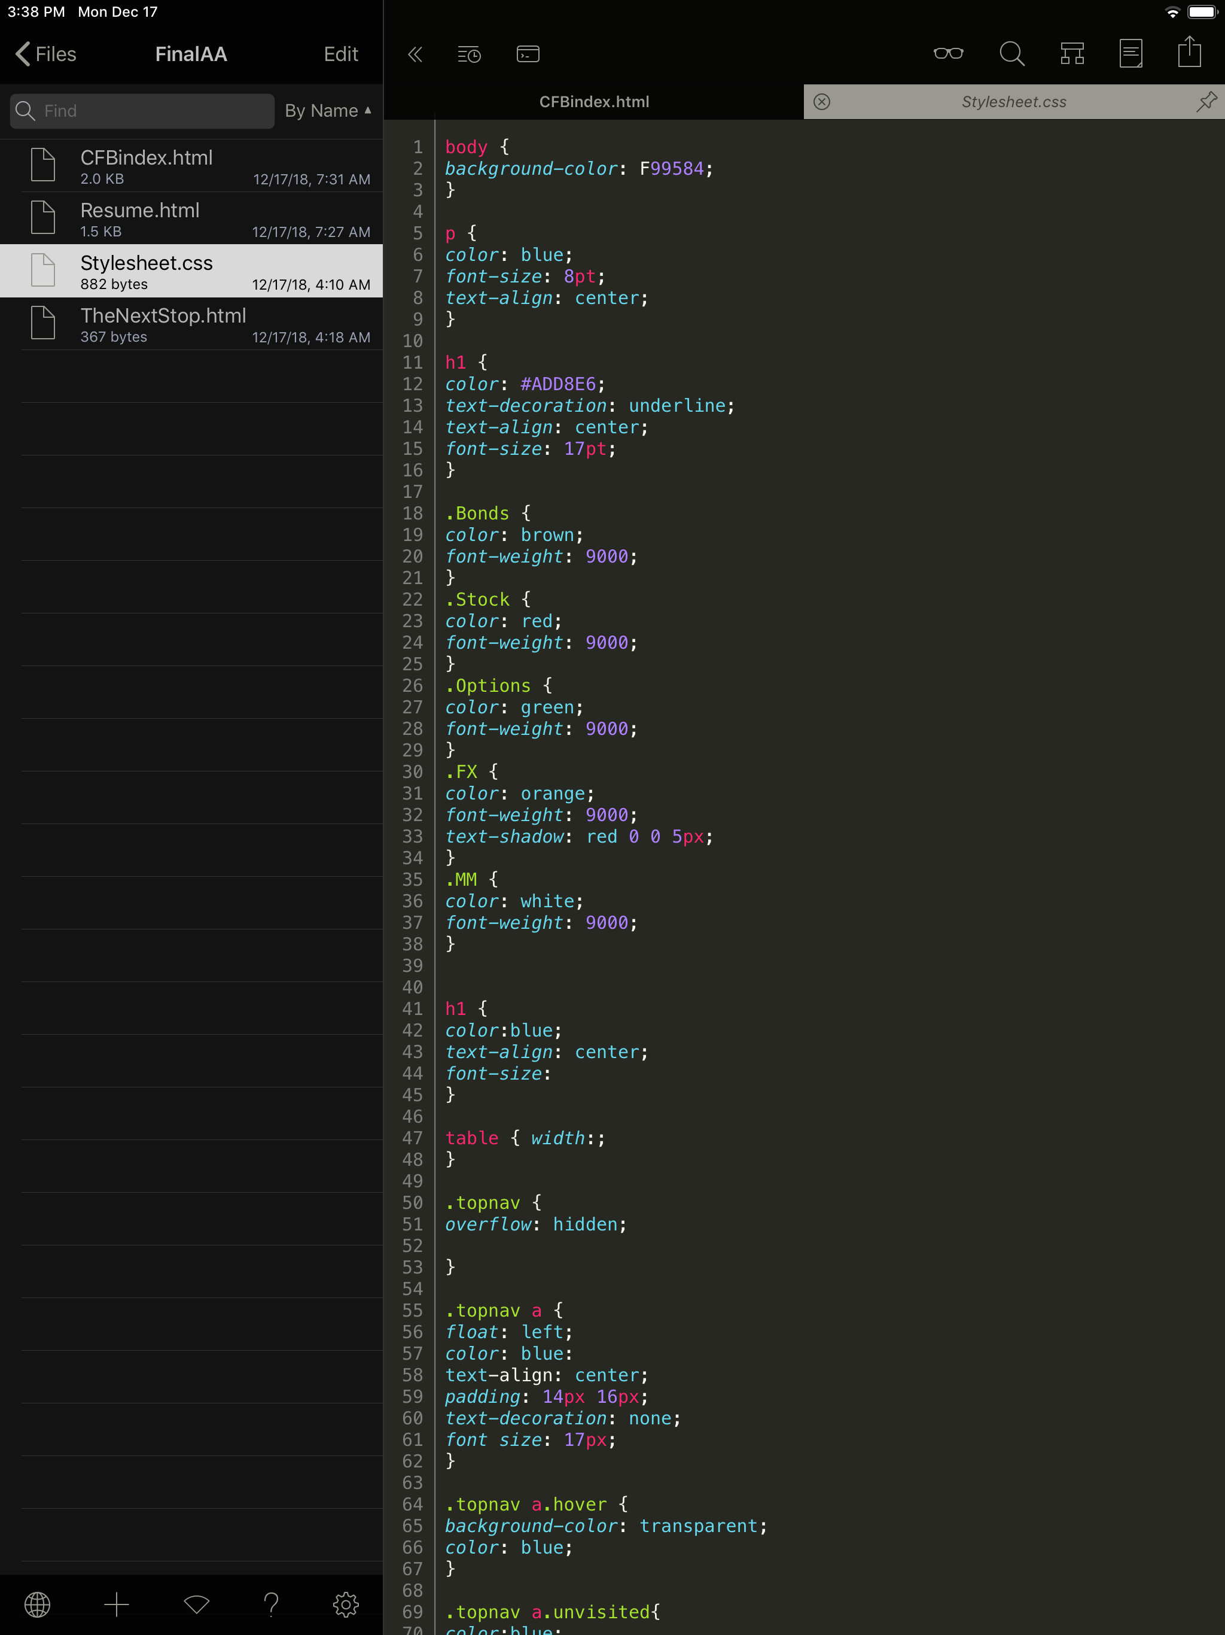

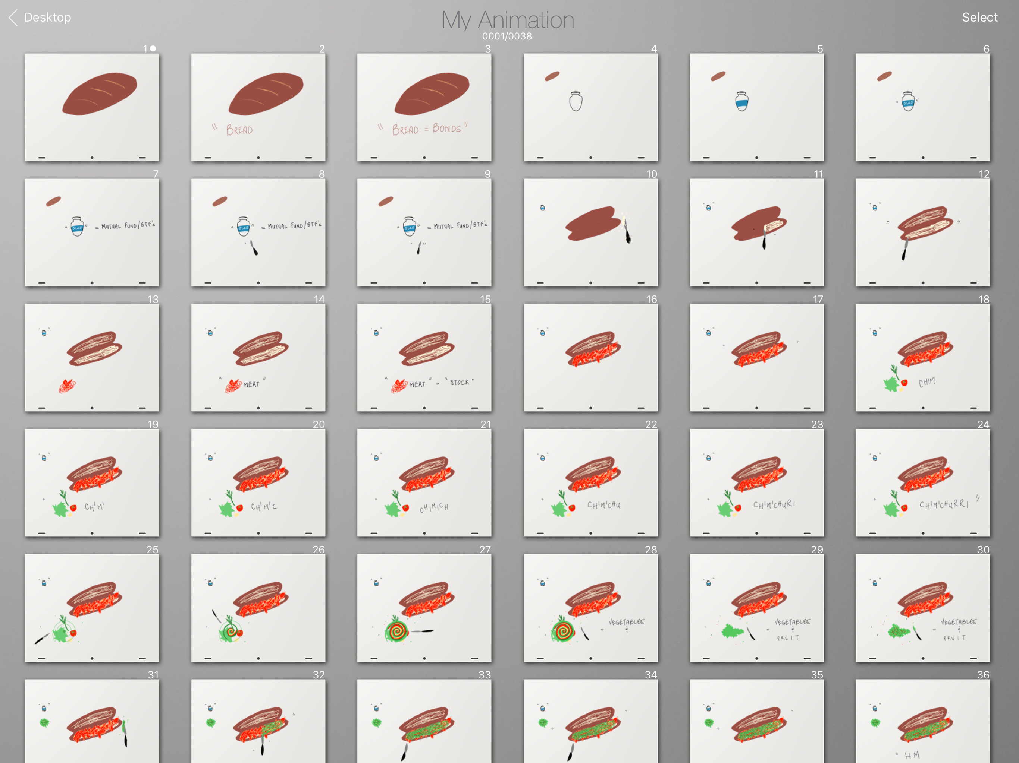
The Process
Utilizing: Animation+, Textastic,
…and I ended with this.

Slide 7
BIBLIOGRAPHY
https://www.usda.gov
https://www.cnpp.usda.gov
https://www.fas.usda.gov
https://www.theguardian.com/business/2018/sep/08/emerging-economies-crisis-looms-shadow-america-boom-interest-rates
https://www.theguardian.com/business/2018/jun/08/argentina-loan-imf-protests-peso
https://www.fic.nih.gov/Global/Pages/NGOs.aspx

